Slide 1

Spam Detection

Slide 2

Members
Abdullah Mohamed El-Sayed El-Kasaby
Abd El-Monem Hassan Rabea
Omar Adel Hassanien
Omar Momen Zohier
Emad Abd El-Hamied Nasr

Slide 3


What is Spam ?
Spam also Called as Unsolicited Commercial Email (UCE)
80% of all Spam is sent by less then 200 Spammers
Mass Emailing to numerous recipients at the same time

Slide 4

Purpose of Spam
Advertisements
Giveaways
Chain letters
Political emails
Stock market advice

Slide 5


Spam As a problem
Consumes Computing Resources and time
Reduces the effectiveness of advertising
Fraud
Consumer Perception
Global Implications

Slide 6

Types Of Spam Filters

Slide 7
Header Filters . Look at headers to judge if forged or not
1

Slide 8
Language Filters . Filters based on email body language . Can be Used to filter out spam written in foreign languages
2

Slide 9
Content Filters Permission Filters
3

Slide 10
Whitelist Filters Blacklist Filters
4

Slide 11




Filter Properties
Filter must prevent spam for entering inboxes
able to detect spam without blocking the ham
Do not Require any modification to existing e-mail protocols
Easily Incremental

Slide 12
Bayesian Classification
Particular words have probablites of occurring in spam email more than others
The filter does not know these probabilities in advance and must be trained
The filter does not know these probabilities in advance and must be trained
to train the filter the user must have a proper dataset

Slide 13
The probabilistic model of naive Bayes
Bayes classifiers can outperform the more powerful alternatives
Being relatively robust, easy to implement, fast, and accurate, naive Bayes
classifiers are used in many different fields

Slide 14
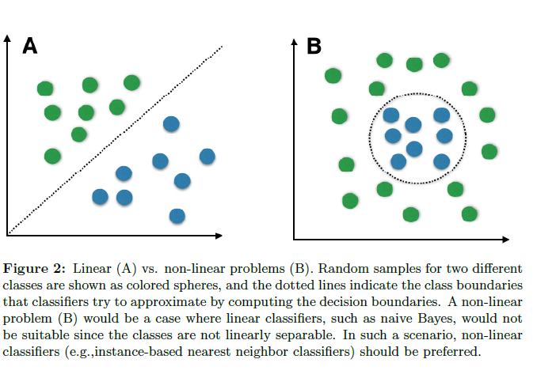
However, strong violations of the independence assumptions and non-linear classification problems can lead to very poor performances of naive Bayes classifiers

Slide 15
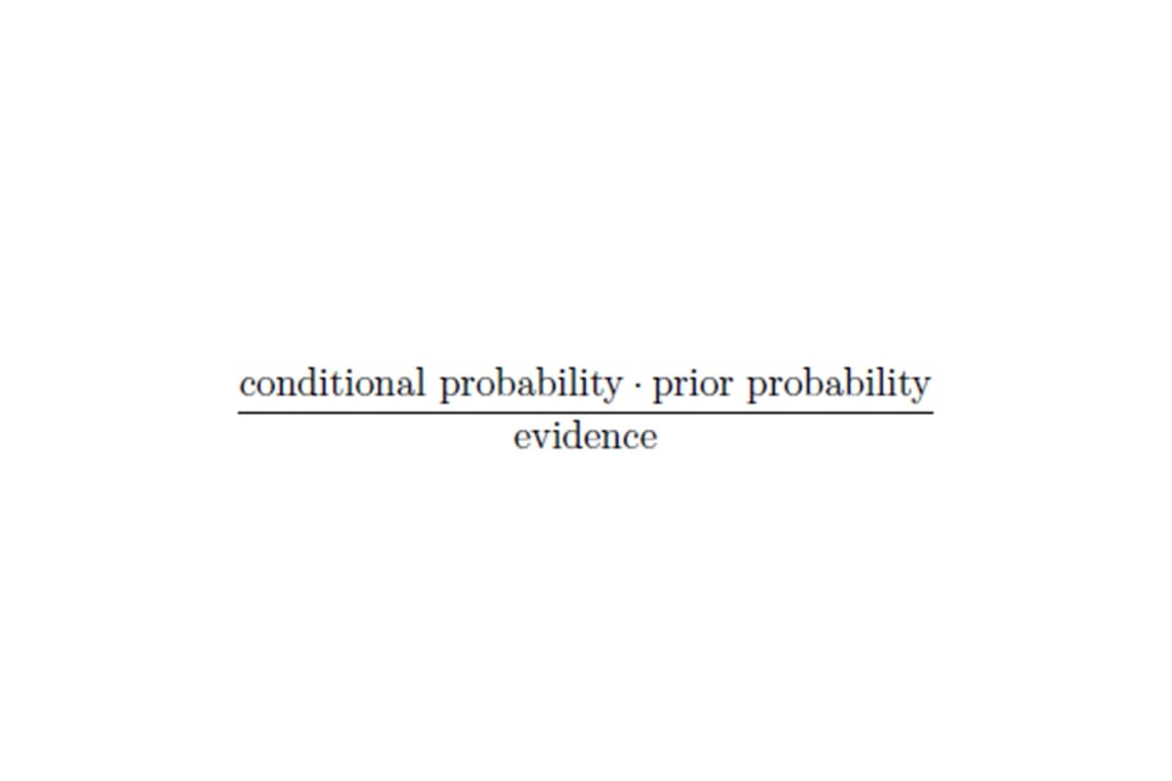
Bayes' theorem forms the core of the whole concept of naive Bayes classification. The posterior probability, in the context of a classification problem, can be interpreted as: "What is the probability that a particular object belongs to class i given its observed feature values?"

Slide 16
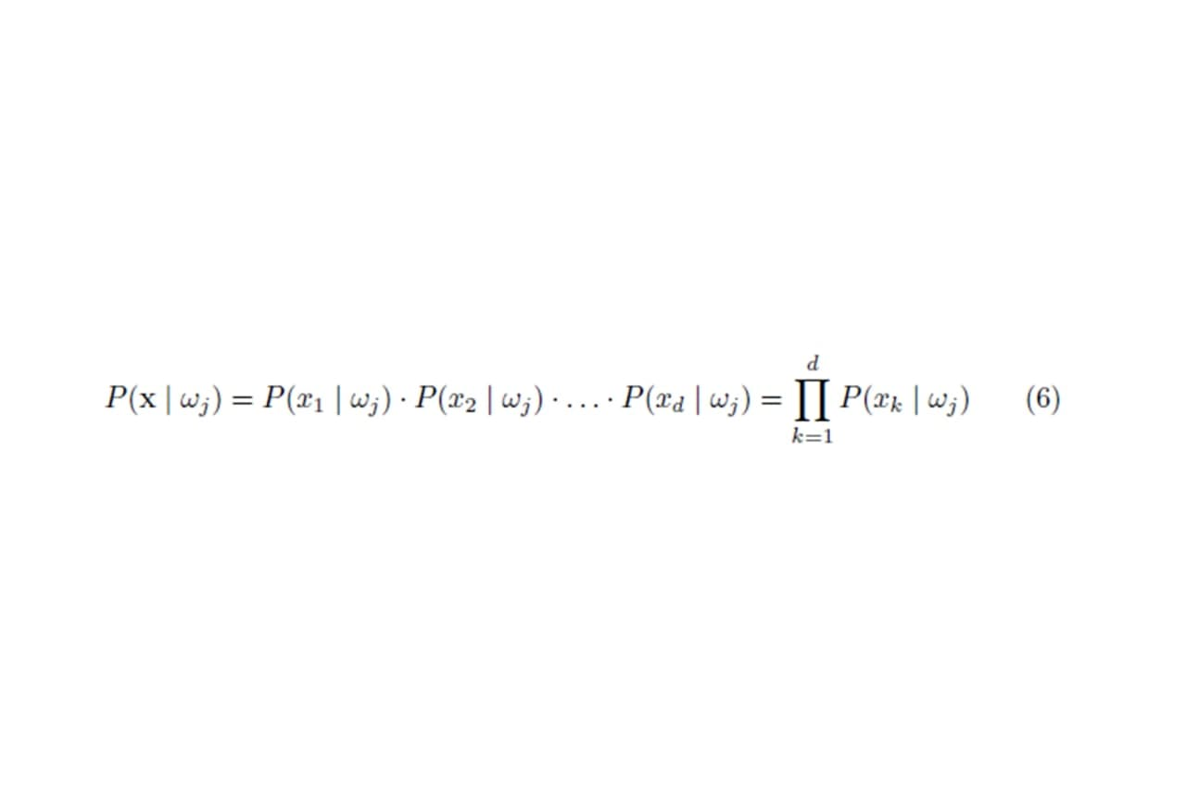
One assumption that Bayes classification make is that the samples are independent and identically distributed.

Slide 17
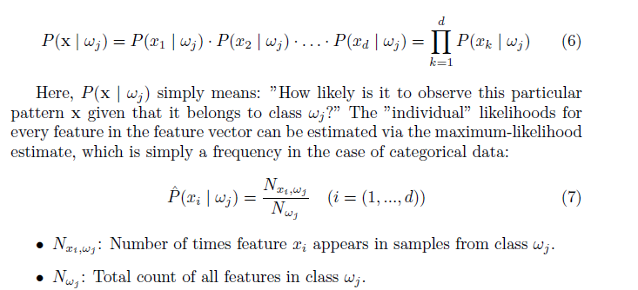

Slide 18
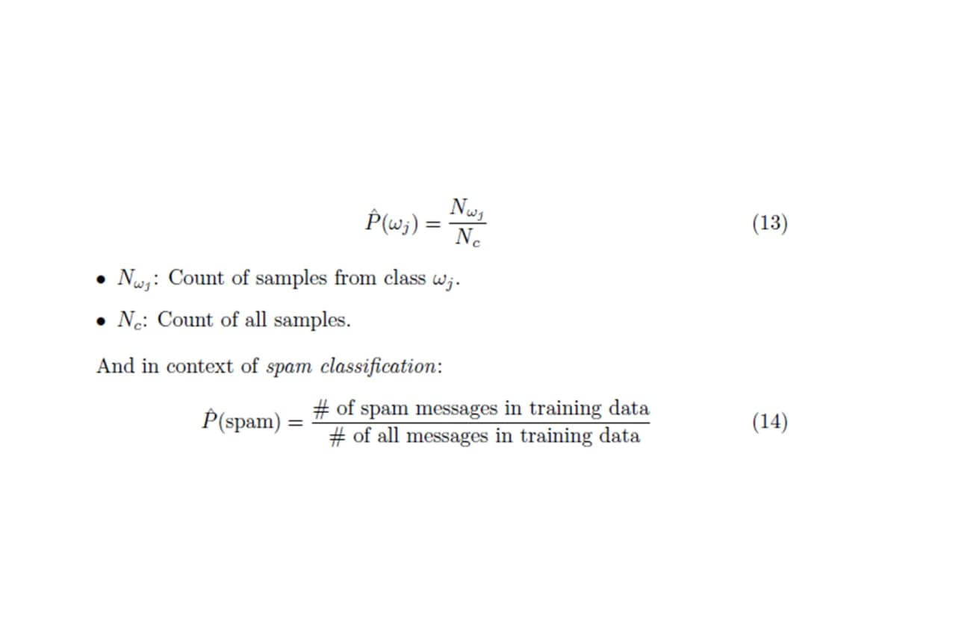
Eventually, the a priori knowledge can be obtained, e.g., by consulting a domain expert or by estimation from the training data (assuming that the training data is i.i.d. and a representative sample of the entire population. The maximum-likelihood estimate approach can be formulated as

Slide 19
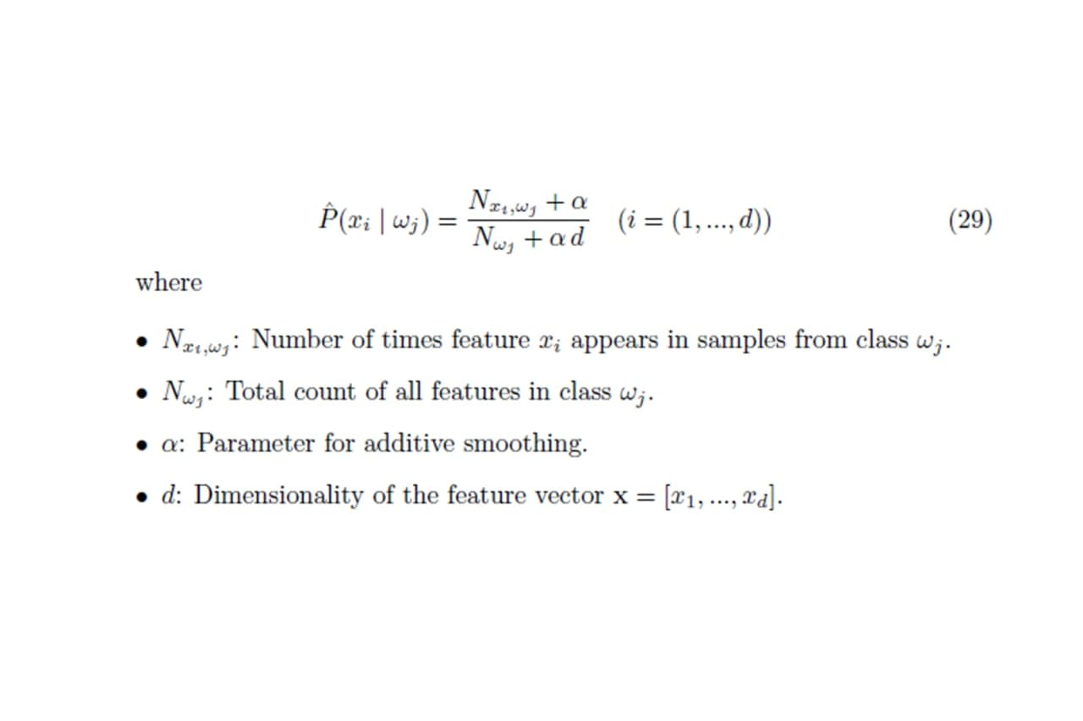
Additive Smoothing The classification was straight-forward given the sample is already present in the dataset. A trickier case is a sample that has a "new" value for is not present in the training dataset. In order to avoid the problem of zero probabilities, an additional smoothing term can be added to the multinomial Bayes model. The most common variants of additive smoothing are the so-called Lidstone smoothing ( < 1) and Laplace smoothing ( = 1).

Slide 20
Pre Processing Steps
Tokenization :
→ describes the general process of breaking down a text corpus into individual elements that serve as input for various natural language processing algorithms
Stop Words
→ Stop words are words that are particularly common in a text corpus and thus considered as rather un-informative
Stemming and Lemmatization
→ Stemming describes the process of transforming a word into its root form
N –grams
→ In the n-gram model, a token can be defined as a sequence of n items

Slide 21
Thank you

